Slide 1
Recruitment and Retention for Rural Markets

Slide 2
Vendors: Recruitment and Retention for Rural Markets
Difference between urban and rural markets?
More urban consumers reported that they learned about farmers’ markets from roadside signs, word-of-mouth, television and newspaper than rural respondents.
Rural consumers (13.85 miles) were willing to travel further than urban consumers (10.55)*
No statistically significant difference was found between urban and rural respondents with
respect to willingness to buy and/or pay more for special foods
*Variation between Urban And Rural Farm Direct Market Customers

Slide 3
Recruitment and Retention for Rural Markets
Reasons for not shopping at farms’ market—factor analysis
Rural | Urban
Factor 1—other reasons | Factor 1—Payment terms
Other | Don’t accept checks
Don’t Feel Safe | Don’t accept credit/debit cards
Raise my own livestock | Don’t accept food stamps
Factor 2—Payment terms | Factor 2—Quality
Don’t accept food stamps | Poor quality
Don’t accept credit/debit cards | Don’t feel safe
Limited variety | High prices
Factor 3—Quality & Special choice | Factor 3—Convenience
Don’t accept checks | Too far
Limited hours | Don’t know of any in my area
Not clean | Inconvenient location
Poor quality | Factor 4—Other
Prefer buying at supermarkets | Limited variety
Factor 4—Convenience | Not clean
Too far | Other
Inconvenient location | Factor 5—Special choice
Raise my own garden produce | Raise my own garden produce
Factor 5— | Prefer buying at supermarkets
Don’t know of any in my area | Limited hours
High prices

Slide 4
Recruitment and Retention for Rural Markets
“Higher vendor satisfaction at relatively newer markets in the region emphasizes the importance for more established markets to continually develop new and innovative market features or activities and to upgrade facilities to maintain and improve market attendance and increase vendor satisfaction.”
“Developing Viable Farmers Markets in Rural Communities”

Slide 5
Recruitment and Retention for Rural Markets
“In addition to providing locally grown fresh and high quality produce farmers’ markets should differentiate themselves
by offering specialty goods (i.e. homemade foods, crafts, shrubs and flowers,) and create a perception of quality
in the physical attributes as well as the uniqueness of the products sold at the market.”
Design the market experience based on the mission and the vendors.
Engage in product development
Conduct seasonal customer niche analysis
Build partnerships

Slide 6
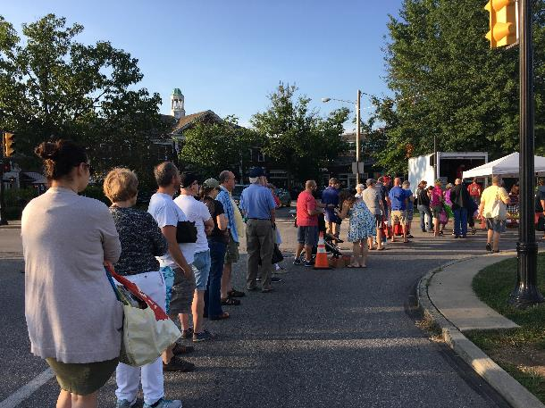
Design the market based on your vendors

Slide 7
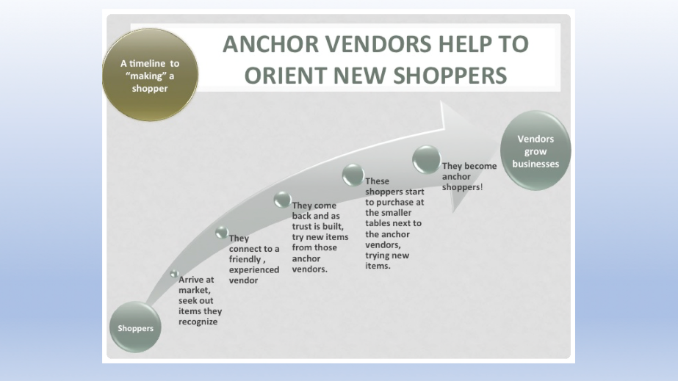
Recruitment and Retention for Rural Markets

Slide 8
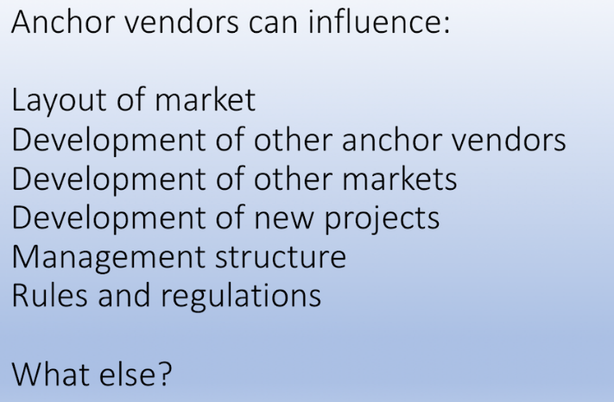
Recruitment and Retention for Rural Markets

Slide 9
Recruitment and Retention for Rural Markets
Question for discussion and to ask your market team:
How do you identify anchors?
Have you discussed the idea of anchors with vendors or market leadership?
Have you done any marketing or technology work or pilots with just anchors? (i.e. match programs)
Are there downsides to being known as an anchor vendor or in defining anchor vendors?

Slide 10
Recruitment and Retention for Rural Markets
Product Development Ideas
Check venues such as supermarkets and specialty stores.
Food, health, and lifestyle magazines and websites; food pages and columns in the newspaper; newsletters; cookbooks; trade magazines and other publications.
Customer surveys, tasting panels, and focus groups.
Vendor surveys.
Chefs and other food professionals.
Cooperative Extension agents and other agriculture professionals.
Meetings and conferences.
Partner with seed companies

Slide 11
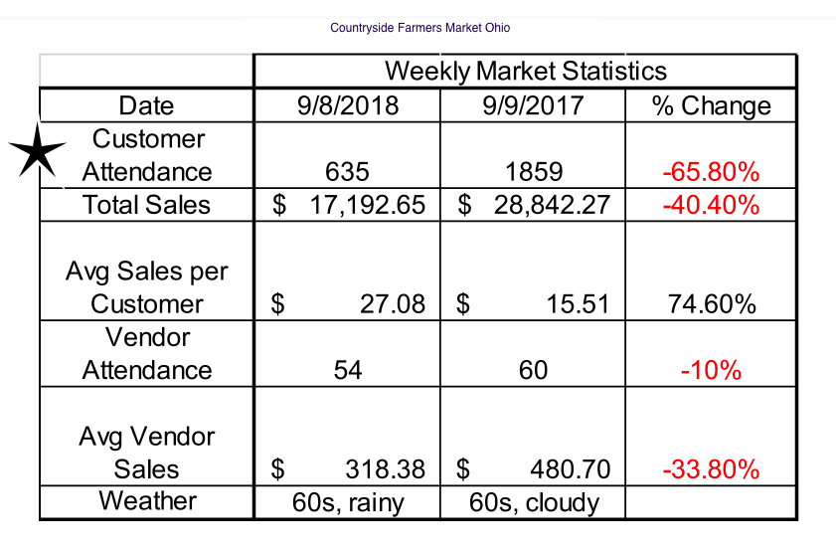
Recruitment and Retention for Rural Markets

Slide 12
How to 1. increase frequency of attendance, 2. amount spent, and 3. new shoppers?
What are things a market might not expect or know about their "average" farmers market shopper?
What are common pitfalls are inhibiting customer expansion and retention?
How effective are events for attracting and retaining new customers?
What are a few key things vendors can do to retain and attract new customers?
Recruitment and Retention for
Rural Markets
Test it with a pilot.
Start that pilot with a hypothesis:

Slide 13
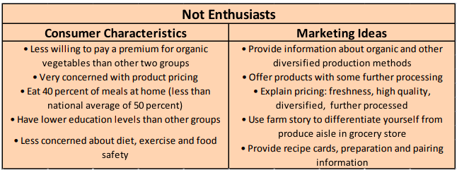
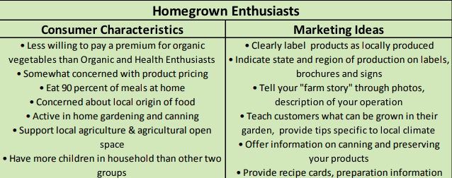
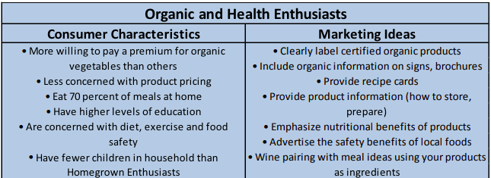
Recruitment and Retention for
Rural Markets
* Marketing Farmers’ Markets: Ideas for Market Vendors & Managers in Nevada

Slide 14
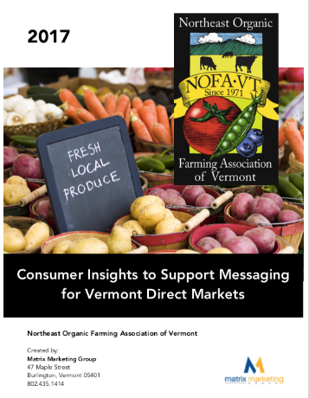
“…the common lifestyles represented in the data:
The Grower;
The Organic Loyalist;
The Value Shopper;
The On-the-Go Shopper;
The Tourist; and
Families….”
“…we found that the values of freshness, quality, price, and supporting local farmers are messages that resonated with Vermonters across all age groups and shopping patterns.”
Recruitment and Retention for
Rural Markets
Vermont psychographics report

Slide 15

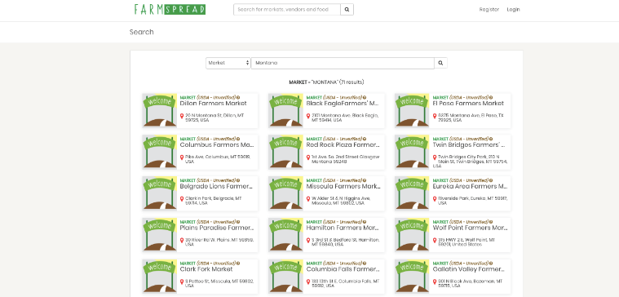
Recruitment and Retention for
Rural Markets
Value-based shopping/directories
https://aeromt.org/abundant/

Slide 16
*In-Kind Advertising & Free Media The Department of Transportation puts magnetic signs about the market on their vehicles, providing free advertising to the market. The local newspaper writes an article on the market almost every month, and the market has also been featured in Greene Living Magazine.
• Special Events & Cooking Demonstrations The market hosts special events to attract more market customers, and publicizes them through their website, the county webpage, the newspaper, Facebook, and the Greene County news & announcements for employees. They secured grant funding to pay for a chef to do cooking demos
* Farmers’ Market Challenges in a Rural Setting: A case study of the Elaney Wood Heritage Farmers Market
Shoppers: Recruitment and Retention for
Rural Markets

Slide 17
Funding will allow the Hernando Farmers Market to facilitate meetings and invite experts to lead training workshops and resource development for market vendors, working in partnership with other markets. Support from Extension will offer seasonal food handling and risk management technical assistance to market vendors throughout the three years of the project.
“I’m looking forward to providing the educational opportunities to help grow the market which in turn helps the growers and young farmers have a place to sell,”
Joy Anderson, DeSoto County Extension.
Recruitment and Retention for
Rural Markets
Partnerships

Slide 18
Sprouting Farms, is a newer program training and incubating new farmers in two valleys in central West Virginia. The project, which aims to create 20 new businesses and 33 jobs, also hopes to leverage nearly $1 million in additional investment from private and public sources.
Recruitment and Retention for
Rural Markets
Partnerships

Slide 19
Recruitment and Retention for
Rural Markets
Rural markets should spend as much time defining their mission and marketing as urban markets.
Which vendors are drawing shoppers to the market on the strength of their products or customer service and how do you work with that?
All markets have to become more adept at growing new-to-markets vendors AND increasing product variety among existing vendors with technical assistance.
Craft a niche message as to what the market is designed to do in its community.
Know how people use the market.

Slide 20
Recruitment and Retention for
Rural Markets
Collect data, Use it.
Mystery Shops
Focus Groups
Surveys
Observation
www.farmersmarketcoalition.org
www.farmersmarketmetrics.guide

